Slide 1

Basepollz
Kenny Ng
TJ DeGirolamo
Jesse Sheehan
Jon Rosenblum

Slide 2
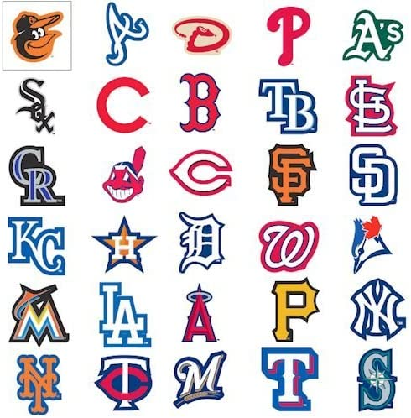
Elevator pitch

Slide 3
concept
Description: A communal site for users to vote on MLB games. Users will track correct guesses and be compared on a leaderboard.
Motivation: Creating an application for the growing popularity of sports betting (slightly restricted by our current capabilities).
User Story:

Slide 4
process
Technologies used: Express, Handlebars, Heroku, Sequelize, Node JS, SQL2, dotenv
Kenny – Backend, Seeding/Models, logos
TJ – Fetch requests & API usage, automatic data refresh(setInterval)
Jesse – Backend, Models, Server Routes
Jon -
Challenges
setInterval – don’t fry any computers
Superagent – allow require(‘node-fetch’), thanks Jesse
Successes

Slide 5
DEMO
Insert pic

Slide 6
DIRECTIONS FOR FUTURE DEVELOPMENT
Actual betting
Include odds
Bet on more than just winner/loser (player performances in game)

Slide 7
Links
Deployed Site: Github Repository: https://github.com/kenng8891/basepollz

